Slide 1

Faculty of Science Department of Computing and Information Systems (COIS)
COIS 2830
Multimedia and Design
Danny Papagiannis
Andy Reid
Thomas Hughes

Slide 2
About this course
This course was created by Brian Srivastava “Sri” and is based on the 2019 Peterborough offering
Thank you Sri!
This version of the course has been updated to include CSS/HTML concepts
Why? You will be utilizing them in future COIS courses

Slide 3
About Me
Hon B.A. University of Toronto
Post-grad certificate Applied Forensic Investigative Sciences Seneca
MA Media Production Ryerson
Using “New Media” since 1983
Two interests: Re-creating reality and Online Networks

Slide 4
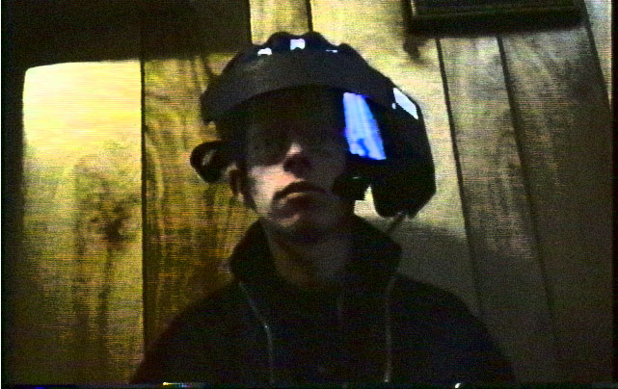
CENTAUR Wearable Computer (1996)

Slide 5
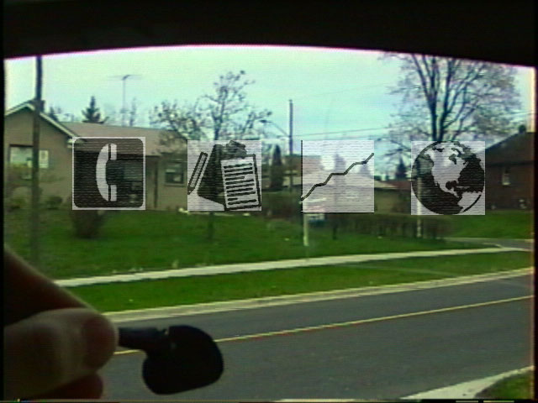
CENTAUR (1996)

Slide 6
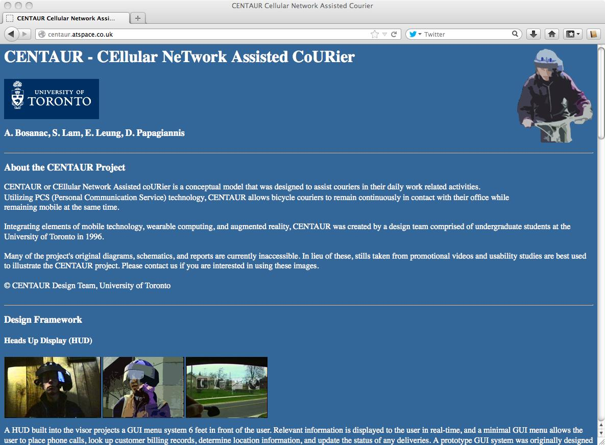

Slide 7
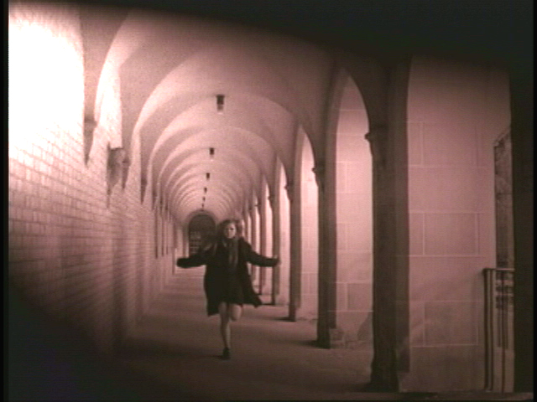
Video Art (1999)

Slide 8
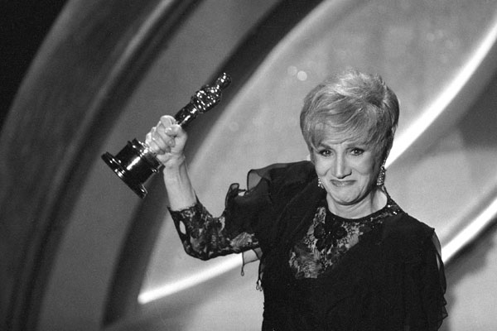
Olympia Dukakis Oscar Best Supporting Actress (1988)
https://dialmformoviesblog.files.wordpress.com/2012/07/1988_02_supporting_dukakis_big.jpeg

Slide 9
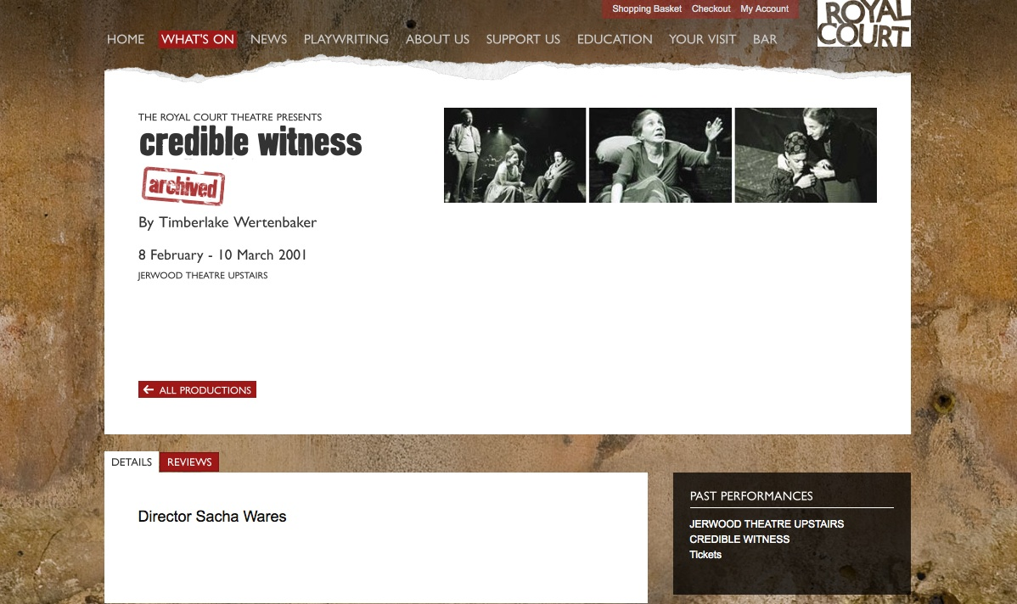
Royal Court Theatre (2001)
http://www.royalcourttheatre.com/whats-on/credible-witness

Slide 10
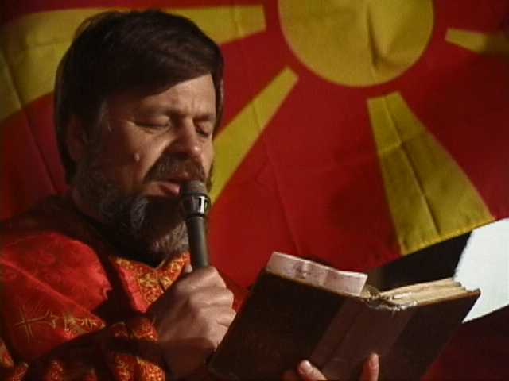
Channel 47/OMNI-1 ENG

Slide 11
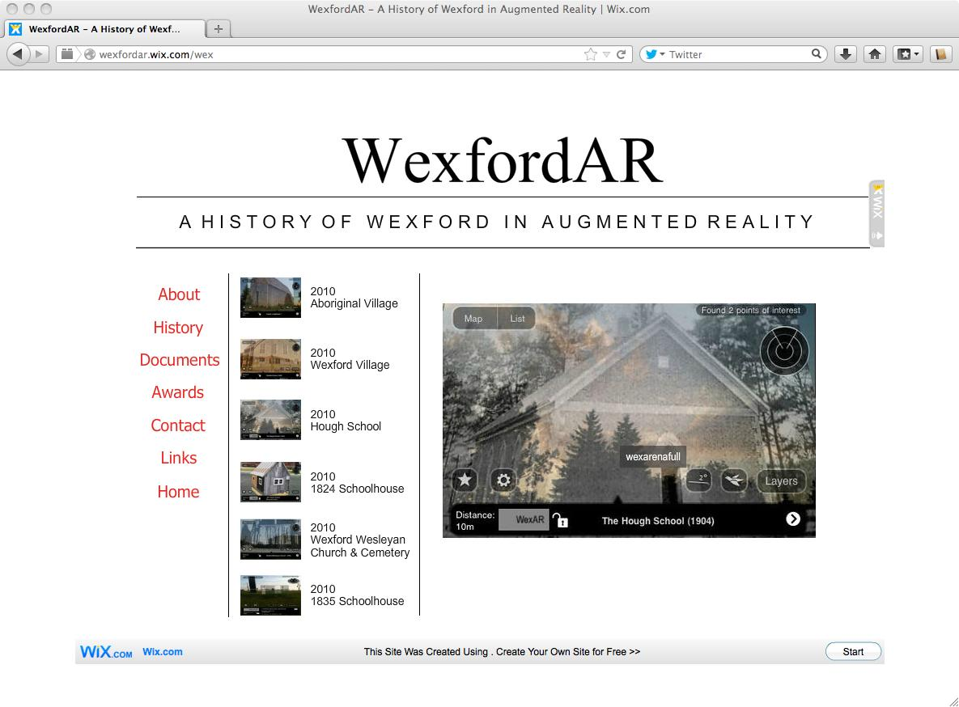
WEXFORDAR (2010)

Slide 12
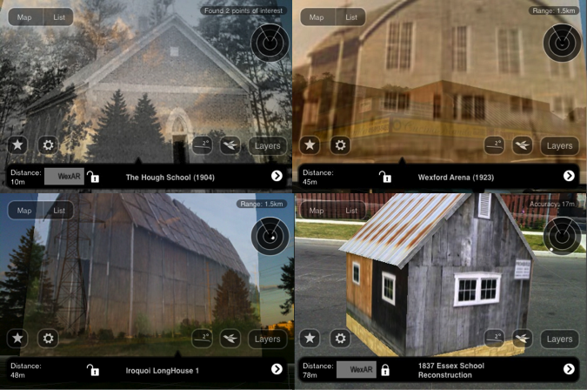
Visualizing History in Urban Augmented Environments: The WexfordAR Project (2010)
Notes:
Test 1 2 3

Slide 13
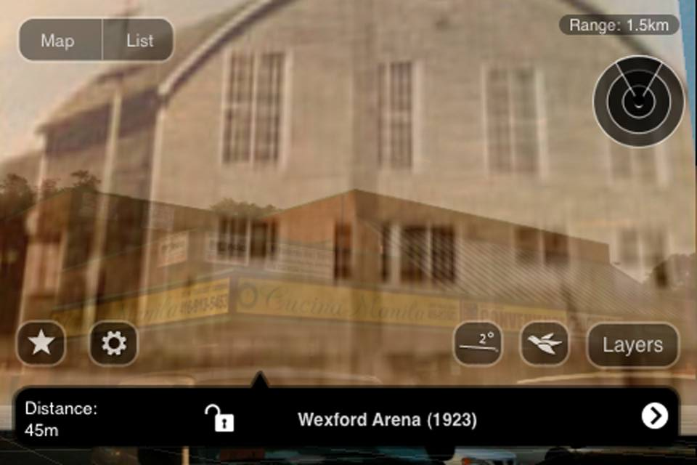
Wexford Arena

Slide 14
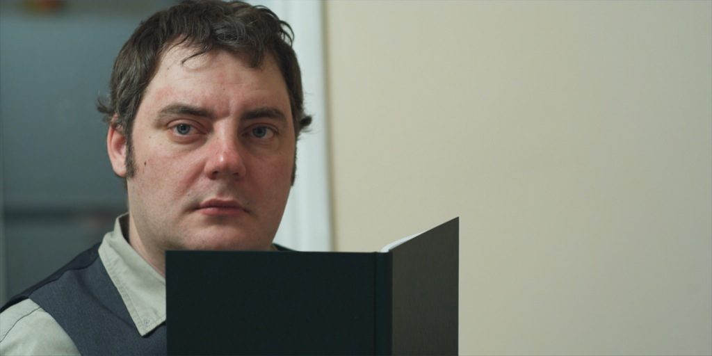
ALAFHAUSEN Working Cut

Slide 15
Digital Media
Digital Media Production
Human Computer Interaction (HCI)
Ethics, Law and the Social Impact of Computing
Serious Gaming and Simulations
Graphic Design
Cybercrime
Project Management

Slide 16

Interactive Digital Culture
Introduction to Animation
HCI for Gaming

Slide 17

Screenwriting and Directing

Slide 18
Information Systems
Multimedia and Design
Digital Culture

Slide 19

Innovation and Growth in Media Industries

Slide 20

New Media Senior Seminar
Theory and Practice of New Media

Slide 21
Workshop Leaders
Andy Reid
Thomas Hughes
Both are experienced Workshop Leaders and have previously taught at Trent and other universities
Welcome!

Slide 22
Questions That Arise
This is a COIS course, and we should use this as a chance to consider (time permitting) COIS problems
Autonomous cars and moral choices
Designing for security (usability vs security)
Fake news – both the spread, and creation of
Internet Search Echo chambers
Online Dating (privacy/big data)
Design languages (this means style)

Slide 23
Evaluations
5 assignments
Best 10 of 11 labs (1 mark each, basically prove that you did it)
Due Dates for each lab will be posted online
Final Exam
Assignment submission is done with you putting your assignments up on loki.trentu.ca, and then submitting the link to blackboard

Slide 24
Type of Assignment | Weighting | Due Date
A1: Basic Webpage, Mostly Image editing stuff | 10% | Oct 1
A2: UI mock-ups for a native application | 10% | Oct 15
A3: Video FX Essay On Security, Privacy, IP law, some webpage improvements – Group Assignment - | 15% | Oct 31
A4: Significant website improvements, multiple versions of website | 10% | Nov 12
A5: Optimising Web UX | 15% | Nov 26
Final Examination | 30% | TBD
Notes:
Labs 10% too

Slide 25
Web Stuff
While not explicitly in the assignment outlines, a big fraction of assignments 3, 4 and 5 will be website construction and layout
But there’s no point in constructing a blank website, so everything we’re doing is content on the website.

Slide 26
Cheating
Don’t
I haven’t the time to be nice about it
https://www.trentu.ca/vpacademic/academic-integrity
Has the rules.

Slide 27
Lateness
10% per business day (i.e. any time on Saturday, Sunday or Monday will all be the same one day 10% late). Assignments will not be accepted if they are more than one week late.
Extensions are possible if there is an emergency, or through arrangement with the instructor in advance. Due dates may be adjusted if there are technical problems with Blackboard or key COIS department equipment.

Slide 28
Lateness Continued
In the past I haven’t really enforced lateness
That got me in trouble
So the policy is the policy, but with a slight caveat. We’re going to take the date you submitted on blackboard as when it was done. But when marking the TA’s can’t see what time you uploaded to loki
So in theory you have the time from when the assignment is due until the TA starts marking (which isn’t going to be at midnight) to make last minute changes.

Slide 29
Non Functional Requirements
Software can be broken down into functional requirements (e.g. saving a file is a functional requirement) and non-functional – the style of the save button for example
This course is largely about non functional, but there’s no point in talking about ideas if you can’t implement
So we’re pushing some HTML and CSS on you

Slide 30
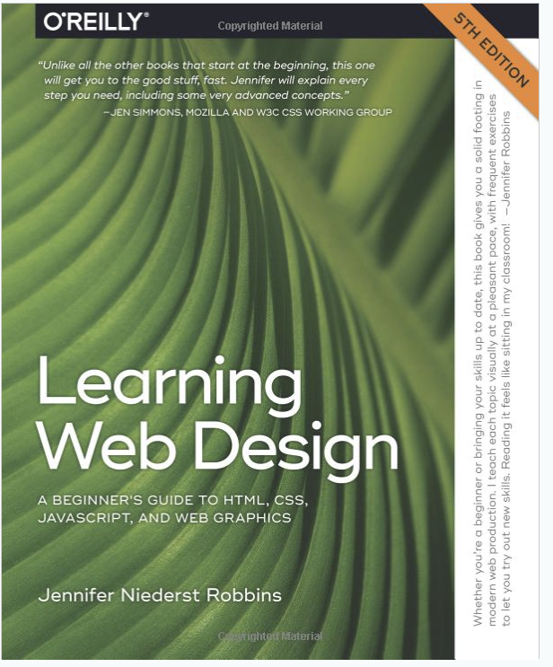

Textbook(s)
This book shapes how you think, it’s an
Important read for everyone

Slide 31
Design and Multimedia
We are going to express ideas about design using multimedia
For our purposes multimedia is
Text
Images
Audio
Video
Interactive (games)

Slide 32
Audio And Video
You will be expected to take video’s (and host them on youtube) for this course, notably for the game design level assignment
You will probably also have an audio file on your website
Previous versions of this course had visual effects editing… that was a disaster for people with thin and light laptops (mostly Macs).
So we had to cut it. Sorry. Squirrel lightsabre duels were cool, but it took far too many CPU hours for what we got out of it.

Slide 33
Lecture Topics
Introduction to key course concepts, terminology, and what it means to be a designer for digital media
Functionality and User Experience
Privacy, Security and Functionality
Building blocks of UI elements (text, colour, shape, material, layout) and how to use them
READING WEEK
UI design tools for applications

Slide 34
Designing for accessibility
Designing for different users (including bots), includes human interface devices, and search engines
User experience testing, and evaluation
Game Design (systems, gameplay, testing)
Game Design, and game systems for serious problems
Review

Slide 35
Implementation
By now you should all know how to produce text on a page…
We’ll do a quick overview of some things you can do to manipulate images between this lecture and the lab

Slide 36
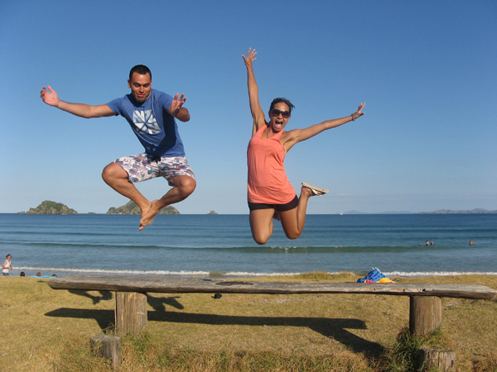

Photoshopping!
Removing people (and stuff) from photos!
These are some random people from a website

Slide 37
Tutorial
http://psd.tutsplus.com/tutorials/photo-effects-tutorials/quick-tip-remove-a-person-from-a-photo-with-photoshop-cs5’s-content-aware-feature/

Slide 38
Computer Graphics?
NO!
None of the good stuffs (algorithms on how to actually implement any of these features).
We’re not going to be photoshop experts or graphic design experts from this. We’re going to have an overview of some of the neat stuff you can do with image manipulation

Slide 39
Image manipulation and Adobe
While I have a habit of saying ‘photoshopping’ GIMP will get the job done.
As will other tools (paint.net would be a prime choice)
E.g.
https://www.youtube.com/watch?v=RZp7BvQJnU8

Slide 40
Legal
Who owns words on a page?
Who owns your phone?
Who owns the software on your phone?
Who owns pictures taken with your phone?
Who *should* own those things?

Slide 41
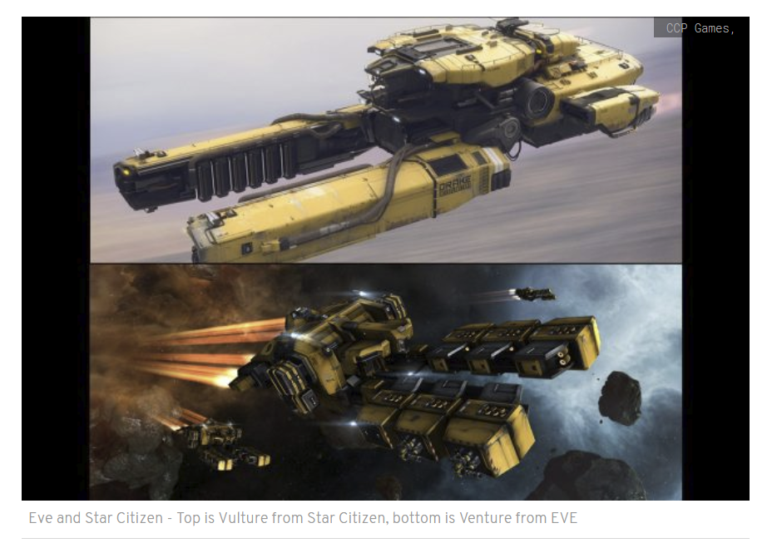
Notes:
https://www.altchar.com/games-news/569954/eve-online-and-star-citizen-fans-waging-a-vulture-vs-venture-war How similar is too similar? Eve and star citizen are video games, Eve has been around for ages. Star citizen is, as of 2018, still under development and one of the ships they released is the one on the bottom

Slide 42
Game Design
What is fun?

Slide 43
Websites
Every Assignment in this course will have a bit of HTML and CSS (probably)
Those are the basis of how information is presented on the web. It’s all of the formatting, style and structure of content. You are expected to apply what we talk about with design to this.

Slide 44
HTML And CSS
For the past couple of years I’ve had students write actual HTML and CSS to make web pages
On one hand, that isn’t hard, but you also don’t get something eye catching.

Slide 45
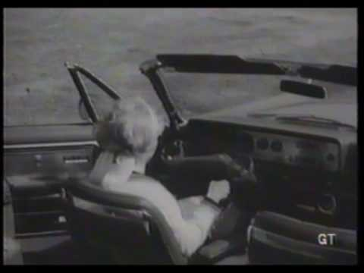
User Interfaces
https://www.youtube.com/watch?v=PWWYkxQCFfQ

Slide 46
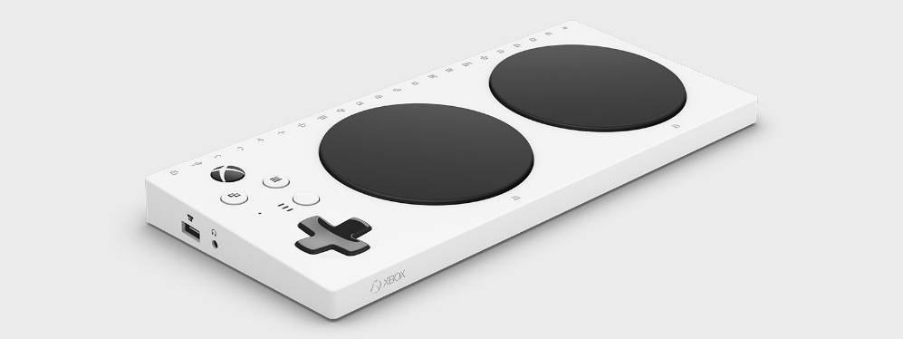
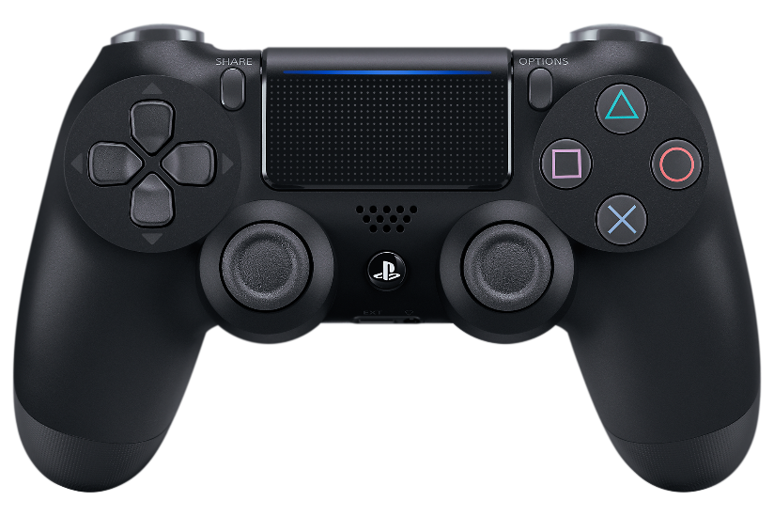
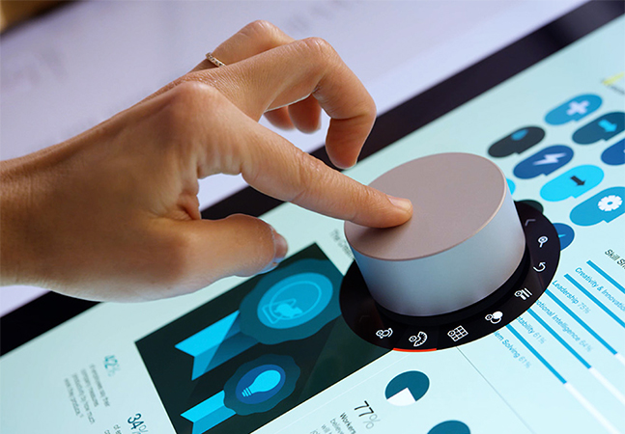
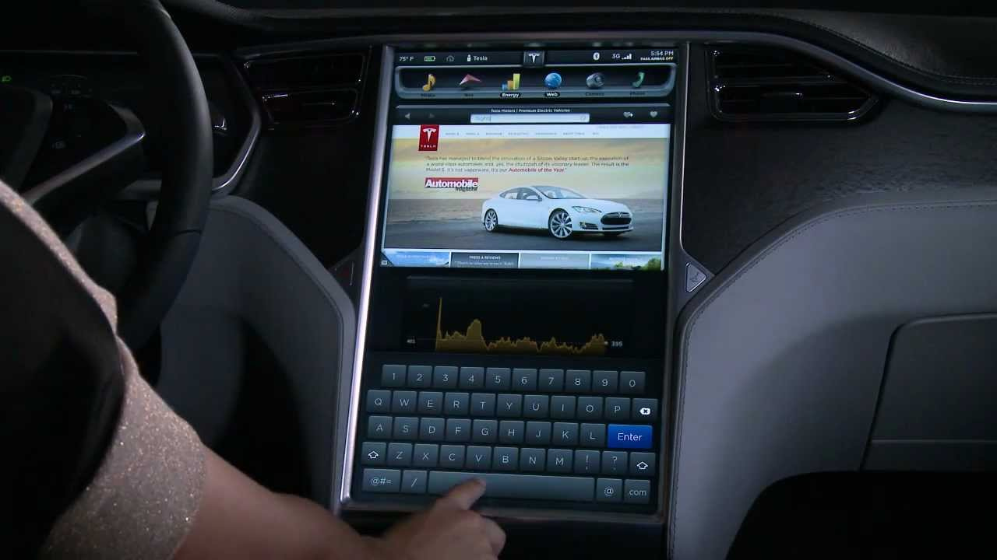
UI Devices for us

Slide 47
UI Devices for Us
https://www.xbox.com/en-US/xbox-one/accessibility
https://redmondmag.com/articles/2018/01/16/adapt-surface-dial-to-a-task.aspx
https://www.playstation.com/en-us/explore/accessories/
https://www.youtube.com/watch?v=TZ0HsN-tblo

Slide 48
Problems
How do you enter a password (or product code) on a PS4 controller?
Can someone with mobility issues or only one arm use a game controller?
What the hell is that Surface dial thing?
How do you safely enter a destination while driving? (or control other vehicle functions)

Slide 49
Design
Design is about understanding who your users are
What problems they will have (and prevent them)
Broadly understanding technical limitations. -No bridges made of depleted uranium.

Slide 50
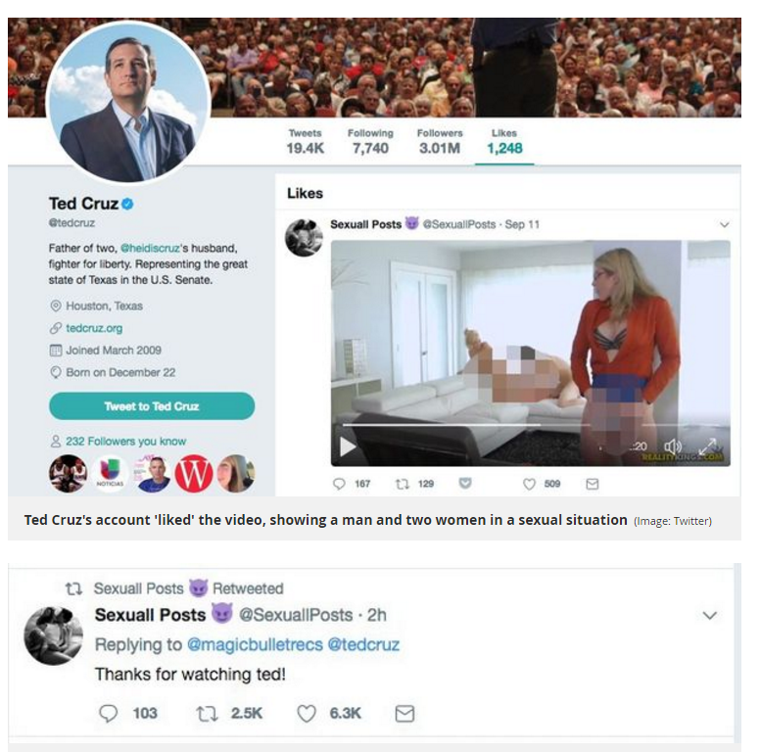
Because It’s Hilarious
US Senator “likes” hardcore pornography video which shows up on his official twitter feed
Which happened in (2017)
UI/UX design!
http://www.mirror.co.uk/news/world-news/senator-ted-cruz-likes-pornography-11152754
Sept 11/12th 2017

Slide 51
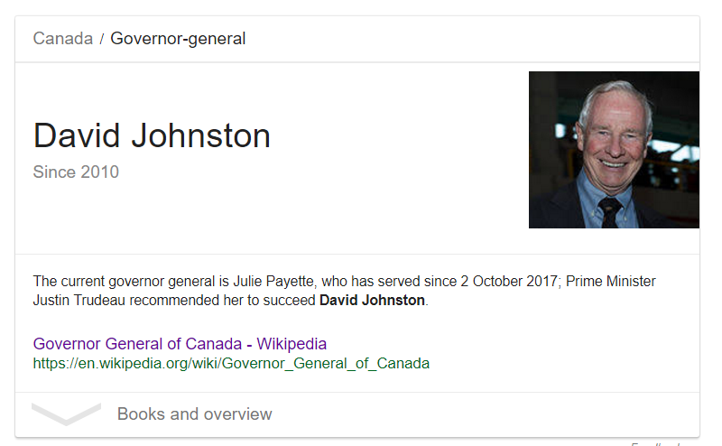
Who Is the Governor-General? Hint: Not that guy.
How does the user know the page is wrong if they don’t read it all?

Slide 52
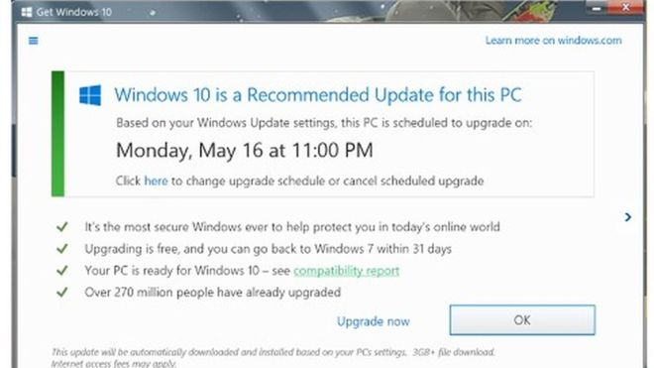
An example From 2016
Notes:
http://www.bbc.com/news/technology-36376962 Clicking OK or X in the upper right starts the upgrade, clicking the “Click Here” changes the upgrade

Slide 53
An example from 2016
http://www.bbc.com/news/technology-36376962 Clicking OK or X in the upper right starts the upgrade, clicking the “Click Here” changes the upgrade

Slide 54
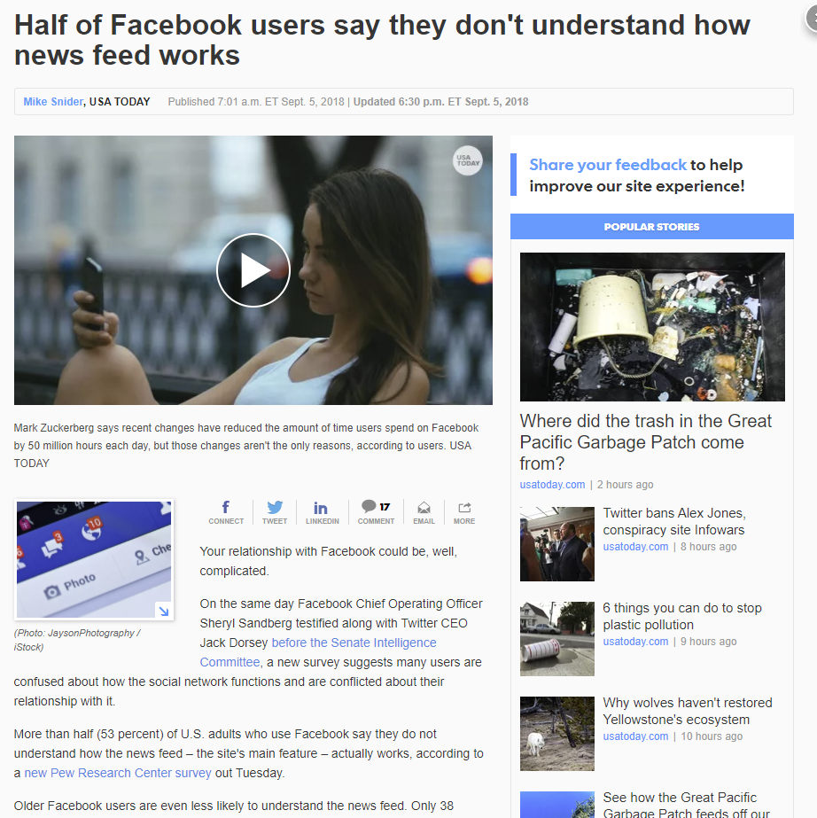
Notes:
https://www.usatoday.com/story/tech/news/2018/09/05/half-facebook-users-say-they-dont-understand-news-feed/1190595002/ Sept 2018

Slide 55
Facebook
https://www.usatoday.com/story/tech/news/2018/09/05/half-facebook-users-say-they-dont-understand-news-feed/1190595002/ Sept 2018

Slide 56
Conflict
Multiple users have conflicting goals or requirements
Technology limits can limit you to A or B (e.g. battery life or performance)
Design is in many cases a series of tradeoffs

Slide 57
Qualitative Design
That’s this course
Understanding the principles that might apply
Shaping how you think about designing things
And what trade-offs you are making

Slide 58
Quantitative design
can be a complex exercise in statistics, modelling, data representation, data collection machine learning
Most of the time that’s a waste of money.
E.g. What colour should this logo be?
How many hundred people do you want to survey for an ‘optimum’ choice.

Slide 59
Reliant Robin Video
Perhaps…. Not so great
And yet it’s illustrative for combining many great ideas
http://www.topgear.com/uk/videos/clarkson-tips-over-reliant-robin
https://www.wimp.com/top-gear-drives-a-reliant-robin-to-find-out-why-it-was-so-popular/
(Same video, BBC is flakey).

Slide 60
If We Have time
We’ll talk later in the course about mobile phones a bit more
But in 2014 mobile usage overtook desktop users in Internet usage.
The problem is that ‘mobile devices’ run a very large spectrum
http://www.smartinsights.com/mobile-marketing/mobile-marketing-analytics/mobile-marketing-statistics/
Notes:
http://www.smartinsights.com/mobile-marketing/mobile-marketing-analytics/mobile-marketing-statistics/

Slide 61
Mobile phones
How many of you are using a phone that was released more than 3 years ago?
How many of you are using a phone that wasn’t a flagship?
That has consequences for security, compatibility and UX

Slide 62
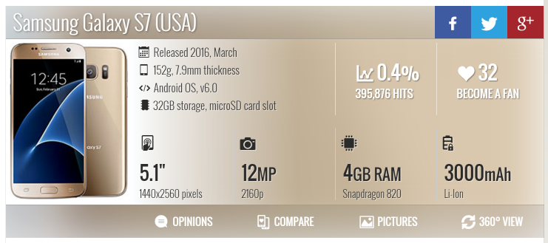
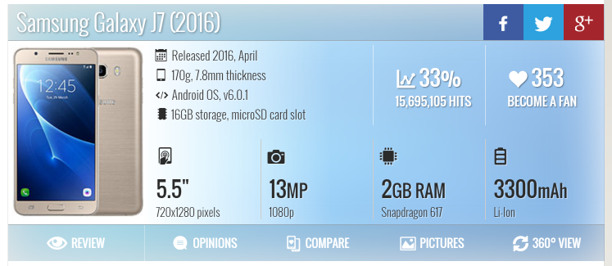
India vs Canada
Notes:
From GSM arena

Slide 63
Canada vs India
Canada GDP per capita – 43000 USD
India 1600 USD
The Galaxy J7 is about 12000 rupees (~180USD) that’s more than an average months pay in India.
That would be like us walking around with phones that cost $5000 CDN

Slide 64
Operating Systems
In 2017 Android overtook Windows as the largest operating system
Windows Owns the desktop (and has since the 1980’s) with about 90% of Desktops and Laptops being windows. Apple is consistently struggling to maintain marketshare at less than 10%
Linux is about 2%
Notes:
http://gs.statcounter.com/os-market-share

Slide 65
The Cloud
One interesting question is how that will change as cloud services go mainstream
Windows is exceptionally good at giving you software for whatever hardware you want – that’s why it’s the best OS in the business by a wide margin
But that concept doesn’t make sense when you are paying someone else for CPU time

Slide 66
(More explanation)
Apple sells you a limited selection of overpriced hardware. It works well on that hardware, but not at all on other hardware
Linux purports to be open, which it is, but it depends on hardware makers to add proper software support. Which most of them don’t.

Slide 67
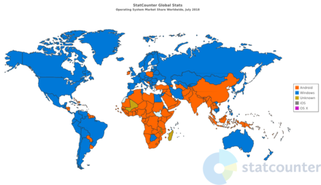
(More)
On mobile Android is king, but largely in poorer countries
Notes:
https://en.wikipedia.org/wiki/Usage_share_of_operating_systems - 2018

Slide 68
Got here in fall 2019

Slide 69
Websites
HTML and CSS (web markup stuff) will teach us how to format webpages, make text look the way we want etc. It’s easy to understand
But understanding when to use those tools well is another matter entirely.

Slide 70
The First Questions
Who are you trying to attract to your site or software?
What are their needs and wants?
What are they trying to do?
Common/rare tasks, levels of access etc.
How often do they use your site? Similar ones?
Conventions or standards?

Slide 71
The Second Question?
How do we build it?
Where do we host it?
What tools do we use?
How do we maintain it?
Computing & Information Systems
cois@trentu.ca and coiscoop@trentu.ca

Slide 72
Technical Stuff
How do you make a simple webpage?
How do you add images and text to it, and format them the way you want?
What counts as a ‘nice’ webpage?

Slide 73
Web Design… good and bad
A lot of what you will do in this course is in the style of a webpage.
But always keep in mind that web pages are a specific problem, and have some specific requirements, and that’s not necessarily how you would make something similar that isn’t on the web (think flyers or newspapers etc.)

Slide 74
Your Webpage
The goal here is to give you the background to make your own page that you can use to showcase your own work outside of just this course
That means you’ll need some assets, some text, etc. so you know how to built it properly

Slide 75
Image Editing
Today will have a high level overview of what sorts of things we can do with image editing, and why
The lab will cover *how*

Slide 76
Image Editing – What And Why
Reshaping images
Size, Colour, Compression
Tone and Contrast
Formats
Moving elements of images around
Correcting photos (colour, scratches etc)
Removing People
Other effects

Slide 77
http://www.cbc.ca/news/trending/no-feature-goes-unchanged-in-revealing-digital-retouching-video-1.3061085
3 videos at the link, watch them
Can you trust what people show you?

Slide 78
https://www.nytimes.com/2017/11/01/us/politics/russia-2016-election-facebook.html

Slide 79

High Level Concept
So in part of course Photoshop is a powerful, useful tool
Was probably made in photoshop… by amazon. To advertise amazon. Obviously.
We will look at free tools, but the same basic thing

Slide 80
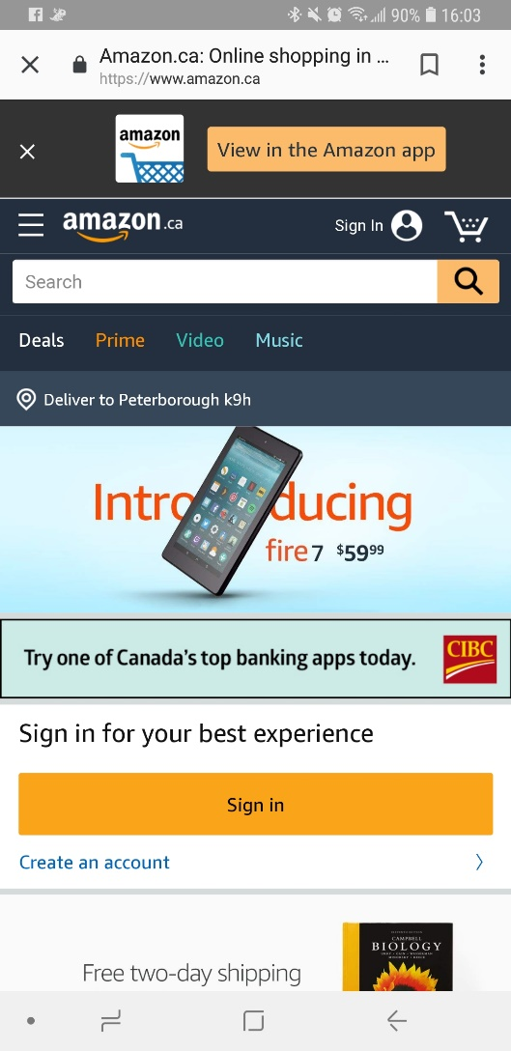
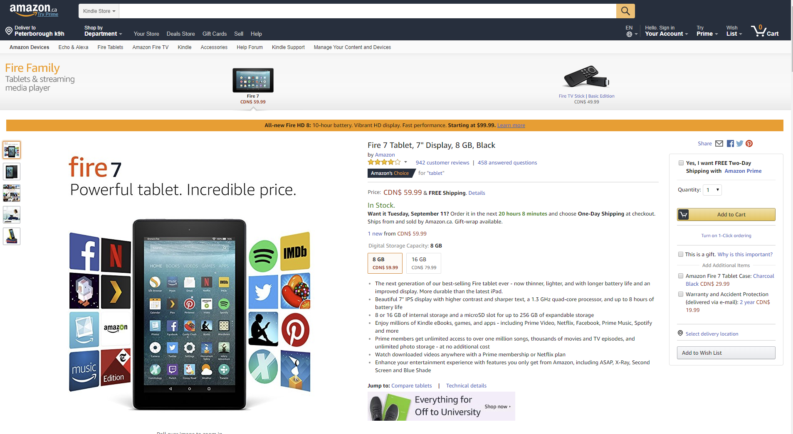
Mobile vs Desktop
Amazon.ca kindle fire tablet
The point here is that it’s the same basic thing, but restructured for mobile versus desktop
Notes:
Amazon.ca kindle fire tablet
The point here is that it’s the same basic thing, but restructured for mobile versus desktop

Slide 81

Reshaping Images
How do you take a wide image and make it narrow, or the reverse?
Notes:
https://webdesign.tutsplus.com/articles/design-a-series-of-smart-banner-ads-in-photoshop--webdesign-5671

Slide 82
Reshaping Images
https://webdesign.tutsplus.com/articles/design-a-series-of-smart-banner-ads-in-photoshop--webdesign-5671

Slide 83
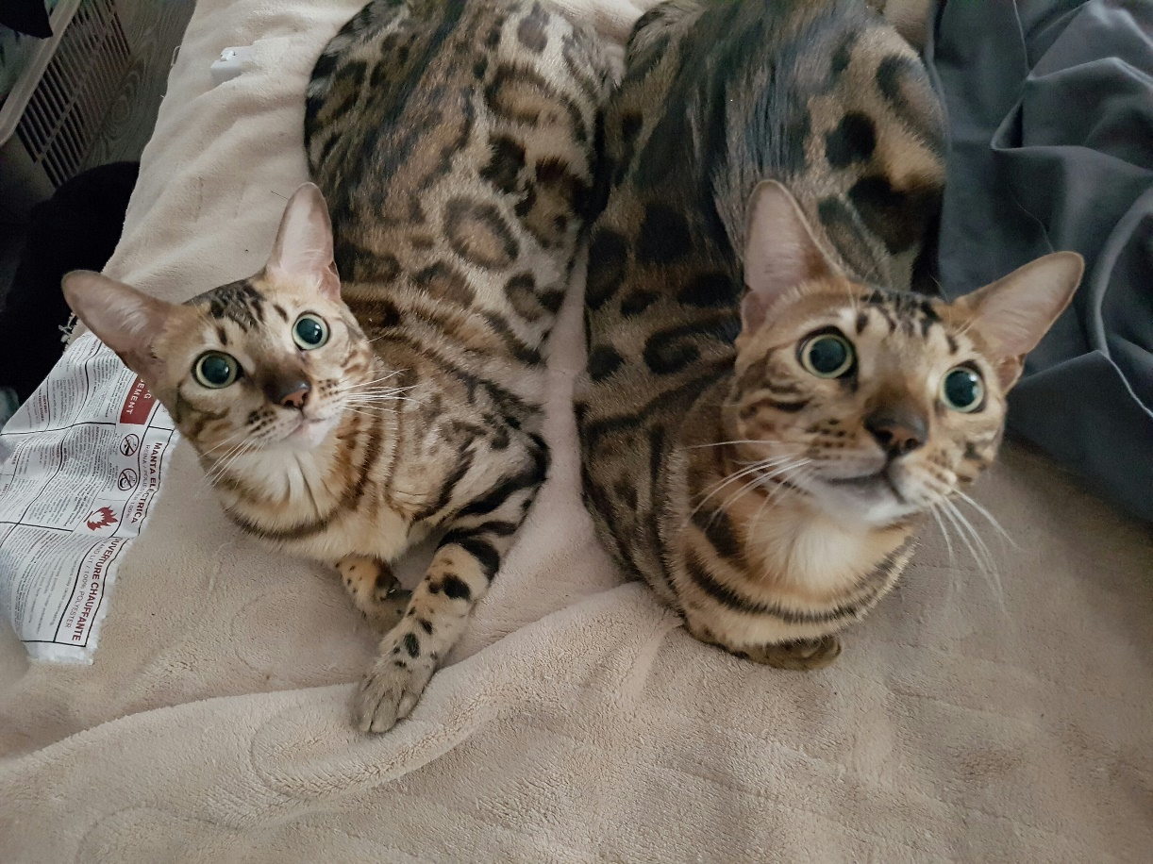
Size
Size I can’t really show you on a slide
But this picture, is 4032x3024, and 7MB

Slide 84
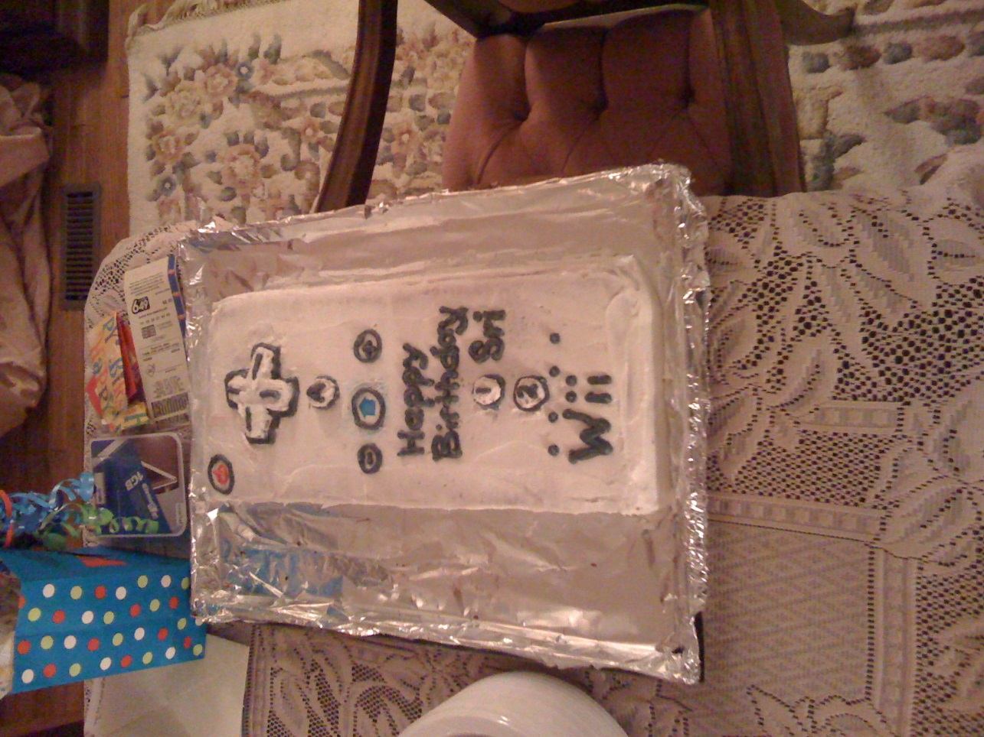
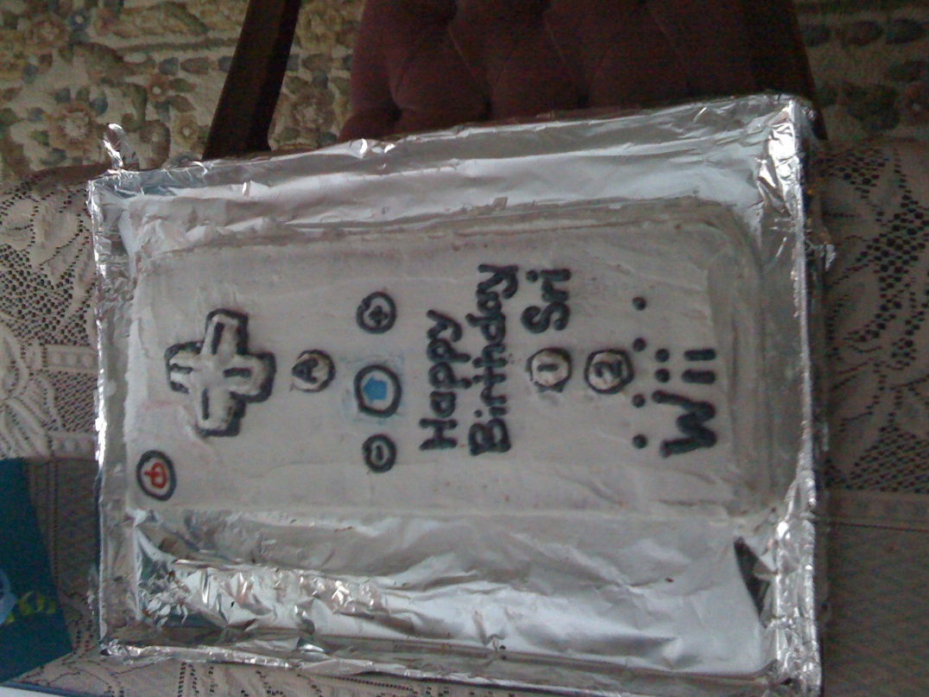
Colour correction
Two photos of the same thing, from the same location… different lighting produces
Very different looking images.
These are from Nov 2008, cake by Jamie.
https://webdesign.tutsplus.com/articles/design-a-series-of-smart-banner-ads-in-photoshop--webdesign-5671

Slide 85
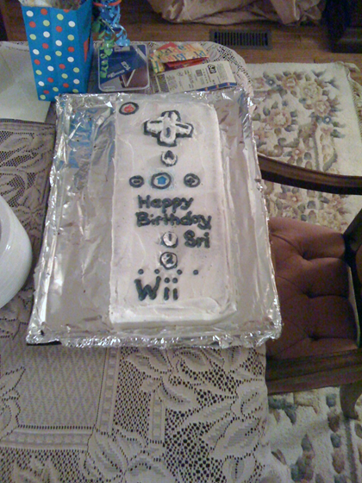

Right unchanged, left Colour, tone and contrast autocorrected

Slide 86
Tone and Contrast
Tone is how many pixels are at which brightness
Contrast is the difference between light and dark areas
You can perform operations which will adjust these values on a raw photograph

Slide 87
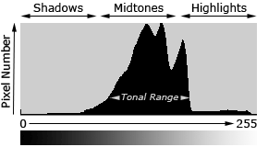
Tone
Tonal range is basically how many pixels are at which brightness
Notes:
You can adjust tone and Contrast in photoshop and GIMP
http://www.cambridgeincolour.com/tutorials/histograms1.htm

Slide 88
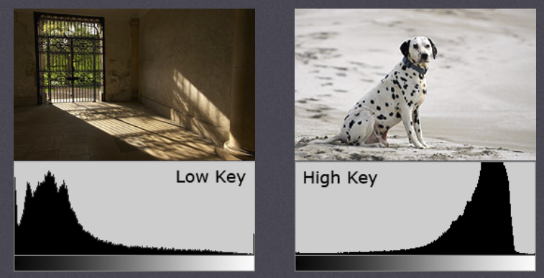
Notes:
https://www.cambridgeincolour.com/tutorials/histograms1.htm

Slide 89
Tone
You can adjust tone and Contrast in photoshop and GIMP
http://www.cambridgeincolour.com/tutorials/histograms1.htm

Slide 90
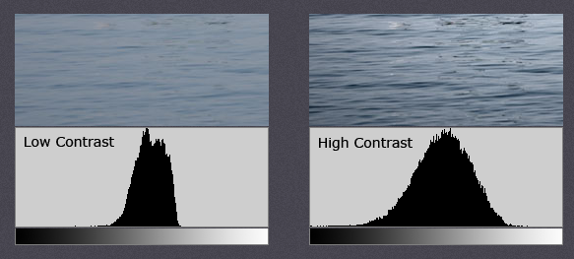
Contrast
This is the difference in brightness between light and dark areas

Slide 91
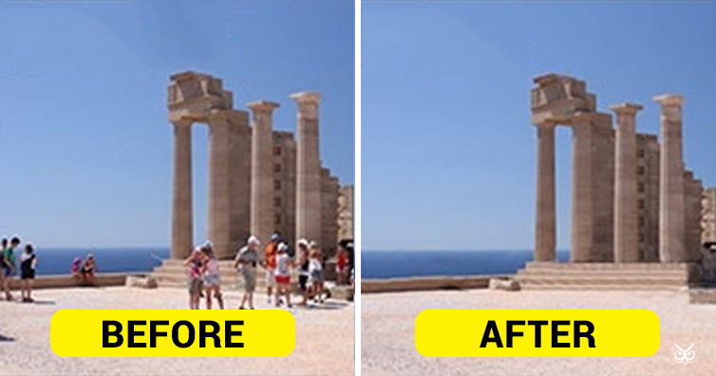
Effects
Averaging many photos to remove people
https://theuijunkie.com/delete-tourists-photos/
Notes:
https://theuijunkie.com/delete-tourists-photos/

Slide 92
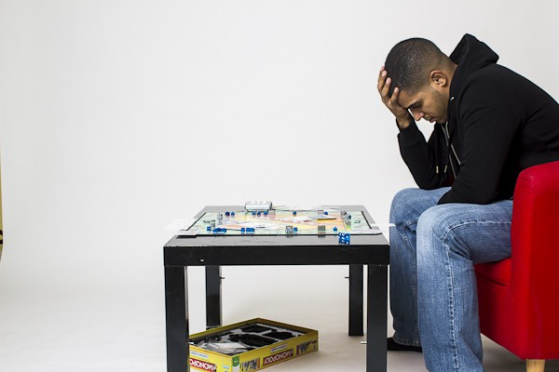
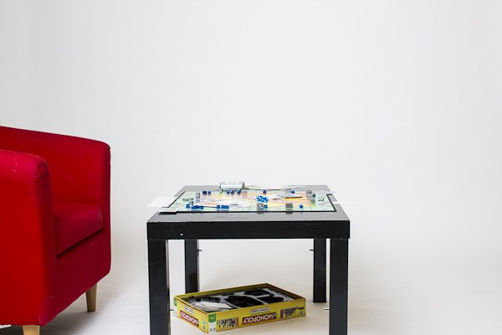

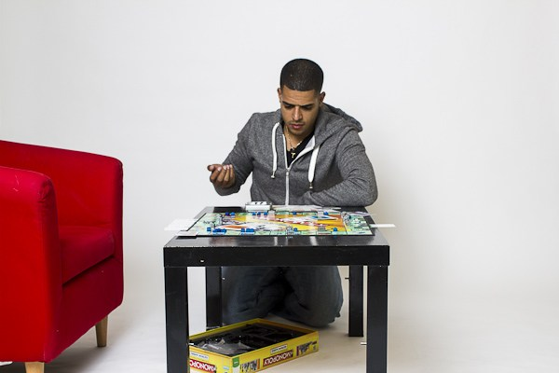
https://digital-photography-school.com/how-to-shoot-a-composite-image/
Notes:
https://digital-photography-school.com/how-to-shoot-a-composite-image/

Slide 93

Notes:
https://digital-photography-school.com/how-to-shoot-a-composite-image/

Slide 94
Format
RAW, JPG, PNG, Bitmap etc.
Trade-offs include: Compatibility, size, quality, ability to edit later
raw is generally the straight image dump from sensors. It tends to be huge, but gives you the best ability to edit
Bitmap is a straight 1:1 pixel to colour format… which is huge and not great

Slide 95
Raw vs JPG
I need to open the Raw vs JPG directory on my computer to show you this (powerpoint doesn’t support most RAW formats)

Slide 96
Joint Photographic Experts Group
.jpeg or .jpg. Pronounced Gif. Because reasons. Lossy, with some lossless versions
PNG, Portable network Graphics. Also lossy but has a lossless versions
Bitmap (simple, big, lossless, supported throughout windows).
Others…… many others.
Reasons – it is the graphical image format by the joint photographic experts group
Notes:
Reasons – it is the graphical image format by the joint photographic experts group

Slide 97
File formats continued
It’s up to you how much you want to play with it.
PNG and JPG are pretty standard and both work reasonably well for our purposes.
As we get deeper into the course there’s some value for each in some context

Slide 98
PNG vs JPG
PNG is usually lossless, and best for text and anything with lines
JPG is usually used in a lossy way, and best for photographs, where you can load the correct version for the device size you are sending it to
PNG supports transparency

Slide 99
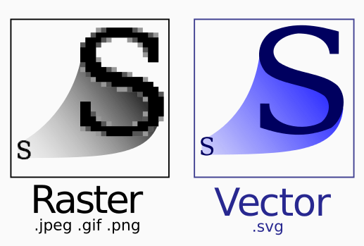
Vector formats
Those other formats all use variants on trying to store information on little squares that make up an image in a compact way
Vector formats store a vector representation of the information which can be displayed at a variety of sizes.
Notes:
Image from Wikipedia on SVG http://en.wikipedia.org/wiki/Scalable_Vector_Graphics

Slide 100
Vector formats
Support for vector formats on the web is spotty
Notably from Microsoft (IE 9 from 2011 introduced support)
Hardware acceleration of rendering isn’t there yet, so while it’s theoretically not bad, they can be slow
(3D stuff definitely has hardware acceleration but we’re interested in 2D images).

Slide 101
http://vectormagic.com/home/comparisons
For sake of interest

Slide 102
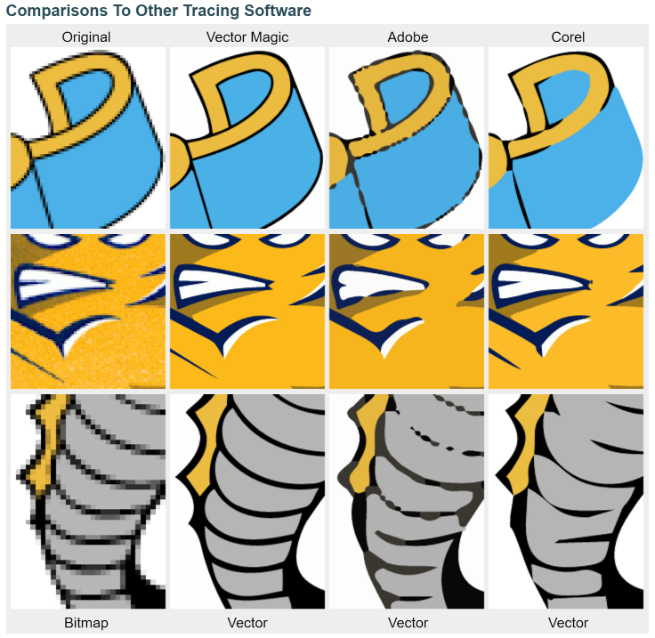
That link Efforts at vectorizing a bit mapped image
Notes:
Efforts at vectorizing a bit mapped image

Slide 103


2015 Google Logo
In 2015 Google switched to a vector format for their images, notably the logo
Notice the change in Font too
https://www.seeklogo.net/technology-logos/google-2015-new-logo-vector-73613.html
https://en.wikipedia.org/wiki/Google_logo
Notes:
Notice the change in Font too
https://www.seeklogo.net/technology-logos/google-2015-new-logo-vector-73613.html
https://en.wikipedia.org/wiki/Google_logo

Slide 104
https://youtu.be/olFEpeMwgHk
If you’re interested (very brief history of google logos)

Slide 105
Size and Performance Matter
While more for later in the course, if you’re on mobile you don’t want to download a 20MB image to load a website
The whole amazon front page on desktop is 1.8MB (which his still huge)
It loads in < 2 seconds.

Slide 106
UI, UX etc.
Getting pages to load fast is critical to UX
2 seconds is pretty much the limit for e-commerce sites. Google (being less e-com and more search) aims for 0.5s
About 53% of users will leave a page if it takes longer than 3 seconds to load.
https://www.machmetrics.com/speed-blog/average-page-load-times-websites-2018/
Notes:
https://www.machmetrics.com/speed-blog/average-page-load-times-websites-2018/

Slide 107
3 seconds and 3 Clicks
The other insight we need talk about is the 3 click rule: it should take no more than 3 clicks to get to content the user wants
Which is really tricky to achieve
There isn’t much scientific basis for the 3 click rule… users will go to many more clicks to find something. Though they may go to a competitor to do so if possible.
https://articles.uie.com/three_click_rule/
Notes:
https://articles.uie.com/three_click_rule/

Slide 108
Summary For Today
High level this course is about learning what makes a good user experience and how to get there
We’re going to experiment with those concepts using web design and some other tools
But ultimately there’s no “right” answers here, there’s just principles. It’s up to you to apply them well

